Slide 1
Circle-Time!
Games and Activities Uniquely Made for Preschool Teachers to Utilize with ADHD Students
By Ashley Bartek and Amiyah Carnall
Notes:
Tailored toward preschool students specifically with adhd and is child-focused.
Easy to access and affordable

Slide 2
Overview
Circle Time
What is ADHD
Goals
Theories
Our intervention: Game Book
Takeaways and References
Notes:
Preschool students with ADHD have a hard time paying attention, remembering tasks, and cooperating. We have a created a game book specifically for preschool teachers to utilize during circle time!! The book includes (this many) games, and they all include tools that improve symptoms of ADHD in the classroom and at home.
Because ADHD is associated with impaired self-regulation and decision making, and this leads to negative educational outcomes
Since the No Child Left Behind Act: Treatment patterns and diagnosis is a wide topic of interest when it comes to teachers and caregivers, which is one reason we created the game book.

Slide 3
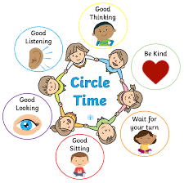
Circle Time
Teacher-child interaction
Quality learning and engagement
Behavioral self-regulation
Rich, warm, and structured
Open-ended questions
Notes:
Bustamante, A. S., Hindman, A. H., Champagne, C. R., & Wasik, B. A. (2018).
Commonly used by most teachers to start the day

Slide 4
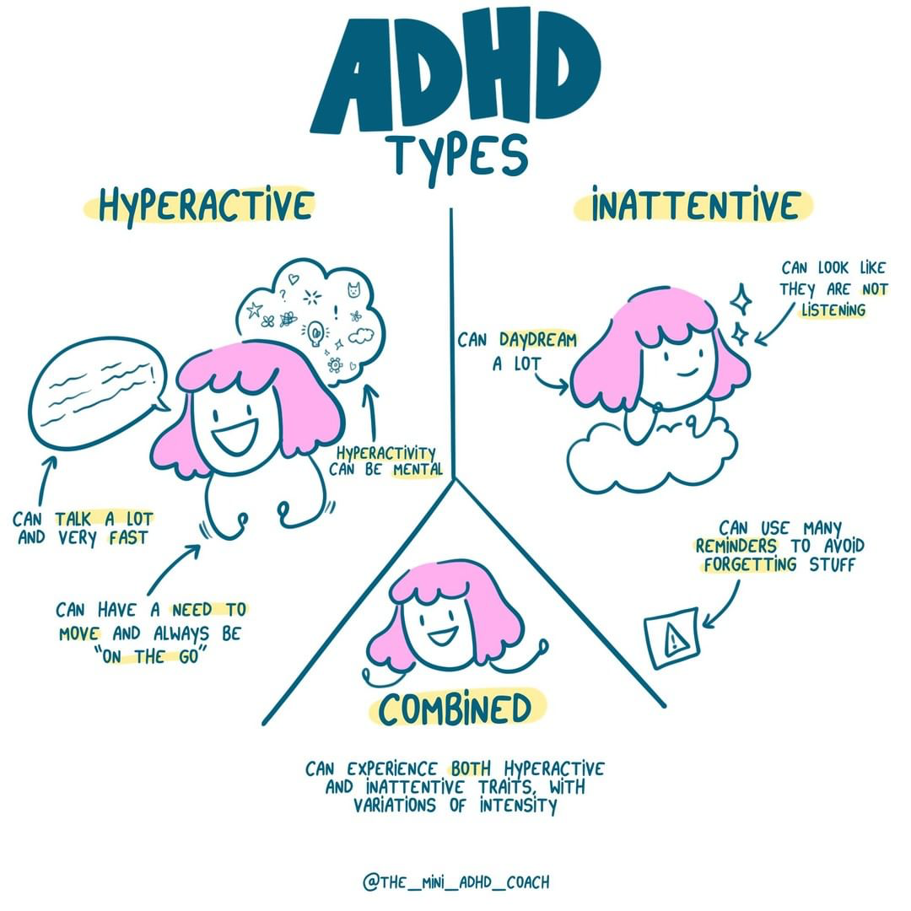
What is ADHD?
Predominantly Inattentive
Presentation
Predominantly
Hyperactive-Impulsive
Presentation
Combined Presentation
(CDC, 2022)
Notes:
“Most common neurodevelopmental disorder in childhood, affecting about 5% of children.”
“Often lasts into adulthood”
May act without thinking what the results may be (our games help with this)
Individuals daydream a lot, forget or lose things a lot, squirm or fidget, talk too much, make careless mistakes or take unnecessary risks, have a hard time resisting temptation, have trouble taking turns, and have difficulty getting along with others
More than half of individuals diagnosed with ADHD are boys
Is easily distracted or forgets details of daily routines, and this makes it hard for the individual to organize or finish a task, to pay attention to details, or to follow instructions or conversations
Fidgets and talks a lot
Which is both equally presented in the person

Slide 5
DSM-5 Criteria for ADHD
Inattention
Hyperactivity and impulsivity
Notes:
“The DSM-5 holds the criteria for ADHD and how to diagnose it. ADHD presents itself as ”
Must:
several symptoms before age 12
in two or more settings
evidence of interference in school, social, or work settings
not be better explained

Slide 6
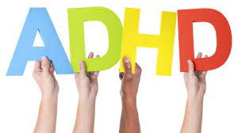
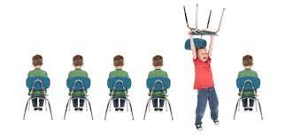
Our Main Goal
Circle time game book to aid preschool teachers in teaching children with ADHD.
Notes:
Children with ADHD in the preschool setting struggle with self-regulation and attention skills. So our main goal is to improve these skills and behaviors needed to succeed.

Slide 7
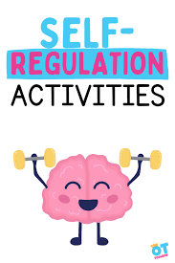
Game Book
Yoga Time
Flat Hat
Red Light Green Light
HTKS
The Freeze Game
Notes:
Greeting song and goodbye song to and from circle time????
Each game is advised to be repeated a second time to ensure opportunity and practice
Children have the option to choose any game from the book
The rules are personalized to each classroom and to the students preference.
Verbal opportunities allow the child to express their social abilities and practice self regulation skills.

Slide 8
Games and Activities
The games and activities enhance:
Memory and learning
Communication skills
Emotional recognition and regulation

Slide 9
Theories and Models
Social Learning Theory
Elaboration Likelihood Model
35
25
22
15
Notes:
We chose social learning theory to explain how specific games improve attention and learning in children with ADHD. (Games are conducted during circle time)

Slide 10
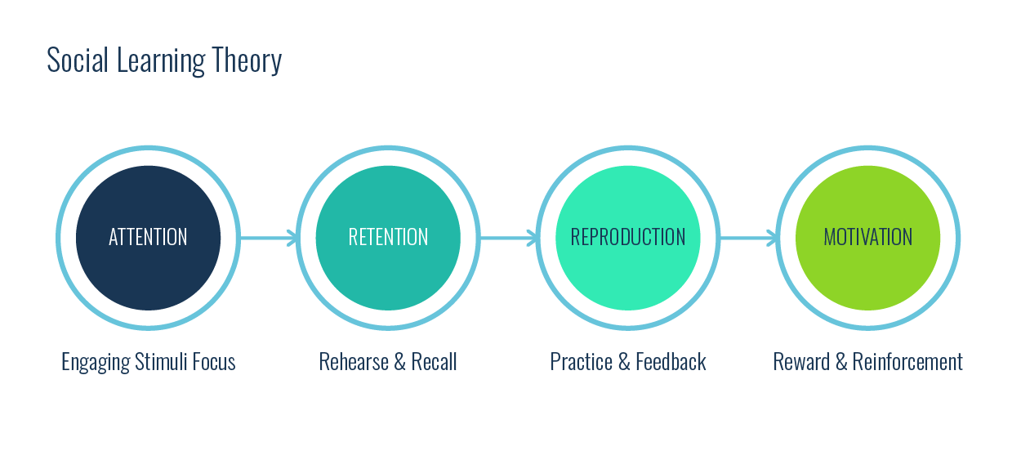
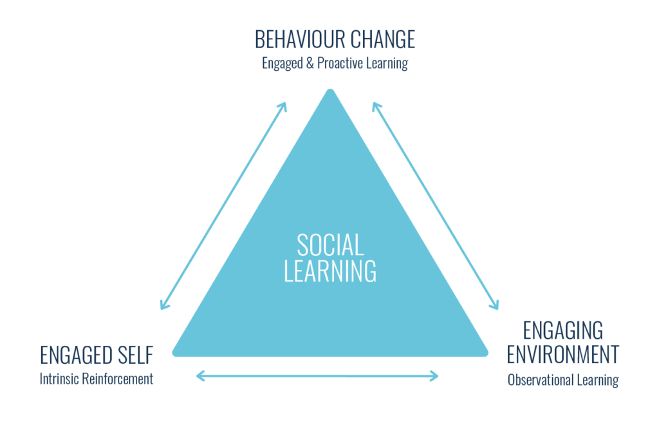
Social Learning Theory
(Growth Engineering, 2021)
Observational Learning
Intrinsic Reinforcement
Behavior Change
Notes:
https://www.growthengineering.co.uk/what-is-social-learning-why-do-we-love-it/
describes the process a person undergoes when interpreting information
social learning theory suggests that we learn through attention, retention, motor reproduction, and then motivation.
Learning is inhibited due to lack of control in attention

Slide 11
Social-Learning Theory Cont.
Online platform for students
Use personalized learning
Give active feedback
Motivate with positive reinforcement
Engage in knowledge-sharing
Notes:
Platform includes Clubs to be involved in, discussion board feeds, and comment sections for parents and students.
Promotes user engagement by producing feel good hormones (oxytocin) invoking familiarity and trust in the classroom
The majority of individuals enjoy constructive feedback this is important for learning the correct information.
Self-determination theory:...
Knowledge-sharing leads to lasting behavior change

Slide 12
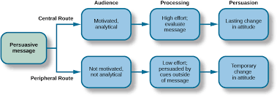
Elaboration Likelihood Model
Central Route:
Lasting change in attitude
Peripheral Route
Temporary change in attitude
Notes:
Elaborating on the lessons and ideas we hear in the classroom is key to fostering and sustaining knowledge. But what happen if we don't experience the intake of the stimulus?
How can we learn if we do not first receive information?

Slide 13
Skills we will enhance:
Communication
Literacy
Attention
Emotion recognition
Self regulation
Inhibitory control
School readiness
Memory
Multitasking
Working memory
Notes:
Goal is to grab ahold of the child’s attention and expand on it
Self-regulation emerges around preschool, so this is an important time to develop
Working memory: child's ability to hold information in memory long enough to complete a task
Inhibitory control is the ability to stop a dominant response like shouting the answer to a question when asked to raise their hand.

Slide 14
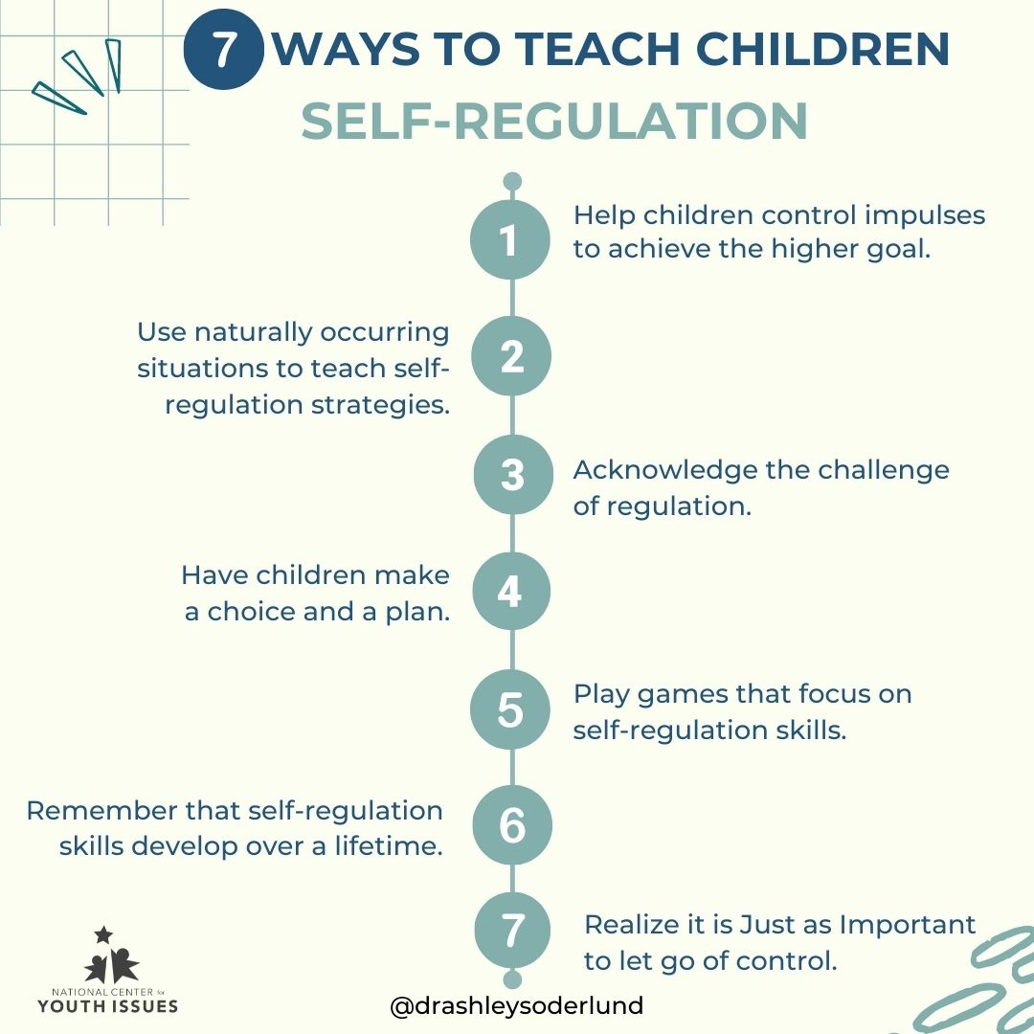
Importance of Self Regulation for School Success:
Self Regulation: the control of one’s behavior through the use of:
self-monitoring
self-evaluation
Self-reinforcement
Tominey, S. L., & McClelland, M. M. (2011)
Notes:
(keeping a record of behavior)
(assessing the information
obtained during self-monitoring)
rewarding oneself for appropriate
behavior or for attaining a goal)
Rules to the game can be flexible to an extent. Giving the children the opportunity to make the rules shows them they have control and it provides experience in leadership.

Slide 15
Emotion Regulation
Controlling behavior, self expression, aggression, and impulses.
Environment stimulation and provocation
Difficult for ADHD students
Practiced skill

Slide 16
Game Book
Yoga
Flat Hat Game
Red light Green Light
The Freeze Game
Notes:
We will briefly describe each game created…

Slide 17
Yoga
Improves attention
Focuses on attention, retention, motor reproduction, and motivation
Cohen, S. C., Harvey, D. J., Shields, R. H., Shields, G. S., Rashedi, R. N., Tancredi, D. J., Angkustsiri, K., Hansen, R. L., & Schweitzer, J. B. (2018). Effects of yoga on attention, impulsivity, and hyperactivity in preschool-aged children with attention-deficit hyperactivity disorder symptoms. Journal of Developmental & Behavioral Pediatrics, 39(3), 200–209. https://doi.org/10.1097/dbp.0000000000000552
Notes:
Strongly backed up by the Social Learning Theory
Focuses on attention, retention, motor reproduction, and motivation
Yoga can be used as a behavioral therapy to reducing symptoms of ADHD in these children.

Slide 18
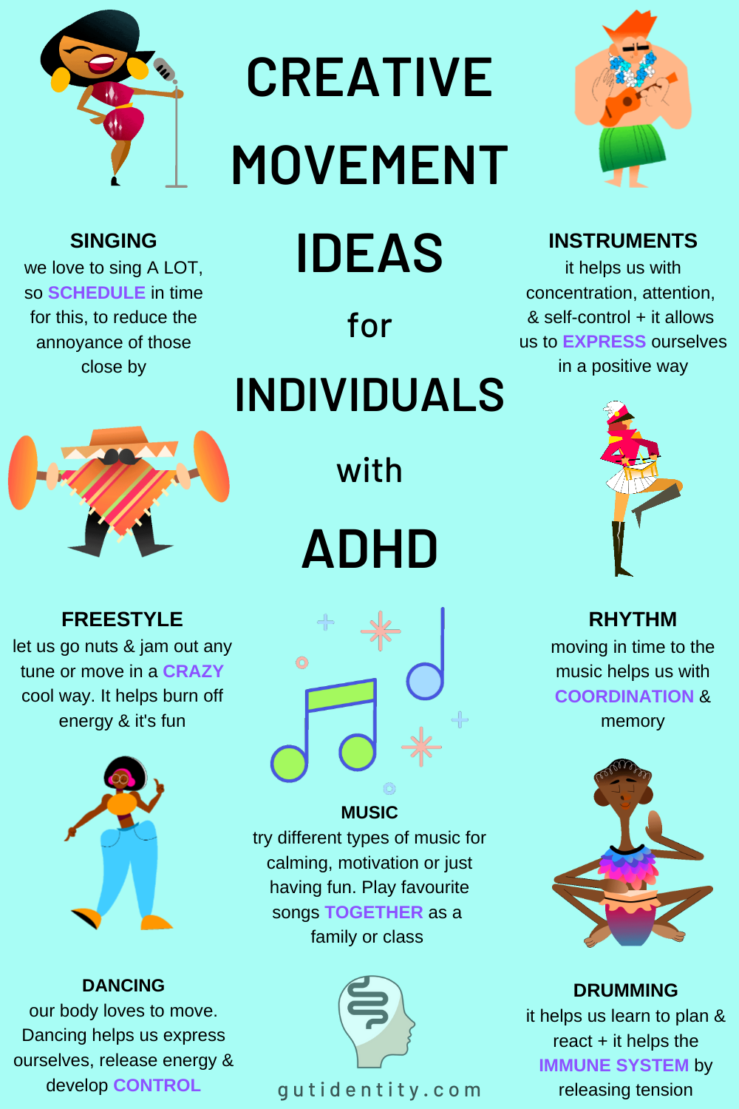
Importance of Movement
Notes:
3 of our games include movement

Slide 19
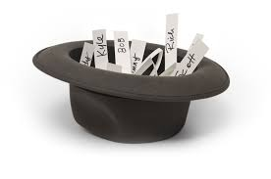
Flat Hat
Engages students from the beginning
Verbal expression and practice
Performance
Allows individual interests to shine
Competitive in nature
Risk and Reward
Notes:
Called the “Flat Hat”, this game requires each student produce a word or phrase of interest to them. Once written, it is placed into the hat and each student has a turn to act out the term until a child guesses it, and receives their reward. Similar to the game… students get to each have a turn acting out and guessing answers,

Slide 20
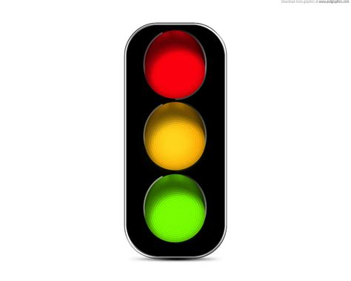
Red Light, Green Light
Stems from the Elaboration Likelihood Model
Opportunity to lead
Elaborates on attention and working memory
Tominey, S. L., & McClelland, M. M. (2011
Notes:
It is important to alternate which color is go and which is stop, because this improves inhibitory control!!
Red light Green light involves various stimulus and this relates to future experiences
This game involves working memory and attention due to starting and stopping cues.
Additional instruction may be added to make this game increasingly more challenging.

Slide 21
Inhibitory Control

Slide 22
The Freeze Game
Children dance or freestyle to music and freeze when the music stops
Alternating between slow and fast songs (dancing quickly to fast songs and dancing slowly to slow songs
The rules are then reversed
Notes:
This game improves attention skills and

Slide 23
Research Findings
Goal of research:
Found through peer-reviewed research articles
Notes:
ADHD children learn best
Our research was found through self-selected peer-reviewed articles.

Slide 24
Practice with your students to improve on their attention and self regulation?

Slide 25
Conclusion

Slide 26
Adair, B. (2019). The emotionally connected classroom: Wellness and the learning experience. Corwin, https://doi-org.ezproxy.lib.uwf.edu/10.4135/9781544356402
Bicard, D. F., & Neef, N. A. (2002). Effects of strategic versus tactical instructions on adaptation to changing contingencies in children with ADHD. Journal of Applied Behavior Analysis, 35(4), 375–389. https://doi-org.ezproxy.lib.uwf.edu/10.1901/jaba.2002.35-375
Bucsea, O., Kosmerly, S., & Rogers, M. A. (2022). Effects of mothers’ parenting sense of competence and child gender on academic readiness in preschool children with symptoms of adhd. Journal of Applied School Psychology. https://doi-org.ezproxy.lib.uwf.edu/10.1080/15377903.2021.2012862
Bustamante, A. S., Hindman, A. H., Champagne, C. R., & Wasik, B. A. (2018). Circle time revisited: How do preschool classrooms use this part of the day? The Elementary School Journal, 118(4), 610–631. https://doi-org.ezproxy.lib.uwf.edu/10.1086/697473
Efstratopoulou, M. A., Janssen, R., & Simons, J. (2019). Children’s deviant behavior in primary education: Comparing physical educator’s implicit theory with diagnostic criteria. Journal of Attention Disorders, 23(3), 246–256. https://doi-org.ezproxy.lib.uwf.edu/10.1177/1087054712449479
Guía, E., Lozano, M. D., & Penichet, V. M. R. (2015). Educational games based on distributed and tangible user interfaces to stimulate cognitive abilities in children with ADHD. British Journal of Educational Technology, 46(3), 664–678. https://doi-org.ezproxy.lib.uwf.edu/10.1111/bjet.12165
Ísfeld Víðisdóttir, S. L., & Sveinbjörnsdóttir, B. (2021). The effects of individualized teaching of school readiness skills to children in preschool with attention‐deficit/hyperactivity disorder symptoms. Behavioral Interventions, 36(1), 315–326. https://doi-org.ezproxy.lib.uwf.edu/10.1002/bin.1756
Krasner, A., Dennis, M., Shoulberg, E. K., Hoza, B., Scott, H., & Martin, C. P. (2022). ADHD behaviors and social functioning in preschool children: The moderating role of emotion recognition. Journal of Psychopathology and Behavioral Assessment, 44(3), 725–737. https://doi-org.ezproxy.lib.uwf.edu/10.1007/s10862-022-09957-9
Miller, J. M. (2019). Evaluating the effectiveness of the tootling intervention in the preschool setting. Dissertation Abstracts International Section A: Humanities and Social Sciences, 80(6-A(E)).

Slide 27
References
Author’s last name, Author’s first initial. Author’s middle initial. (Year, Month Date published). Article title. Journal Name, Volume(Issue), page number(s). https://doi.org/ or URL (if available)
American Psychiatric Association: Diagnostic and Statistical Manual of Mental Disorders, 5th edition. Arlington, VA., American Psychiatric Association, 2013.
Bustamante, A. S., Hindman, A. H., Champagne, C. R., & Wasik, B. A. (2018). Circle time revisited: How do preschool classrooms use this part of the day? The Elementary School Journal, 118(4), 610–631. https://doi-org.ezproxy.lib.uwf.edu/10.1086/697473
Tominey, S. L., & McClelland, M. M. (2011). Red light, purple light: Findings from a randomized trial using circle time games to improve behavioral self-regulation in preschool. Early Education and Development, 22(3), 489–519. https://doi-org.ezproxy.lib.uwf.edu/10.1080/10409289.2011.574258

